Slide 1
Employee Data Analysis Using Excel
Student Name : eyashwin. S
Register NO : 312219560
ID :F4A92C3FEEA6AA1A38E4D1F9FDD17194
Department : B.COM (General)
College Name : Sree Sastha Arts And Science College

Slide 2
Project Title
Using Excel Employee Salary Analysis

Slide 3
Agenda
Problem statement
Project overview
End users
Our solutions and proposition
Data set descriptions
Modelling approach
Results and discussion
conclusion

Slide 4
Problem Statement
When some employee salary records are outdated ,find the current salary of each employee by assuming that salaries increase each year.
Calculate an employee’s gross salary based on their basic salary , hra percentage and da percentage.
When making final salary decisions , employees needs to consider a variety 0f factors , including demographics.an automated decision making system can help generate wage suggestions.
A problem statement is a business document that outlines an issue an proposes a solution to prevent it from recurring.

Slide 5
Project Overview
To ascertain the salary baisis.
To calculate hours worked.
To generate net salary.
Salary is the amount an employee is guaranteed to be paid for a specific time period

Slide 6
Who Are The End Users?
Employers
Use salary analysis to ensure that they are paying their employees fairly and to benchmark their pay levels against competitors. They also use salary analysis to attract and retain employees.
Employees
Use salary analysis to assess their worth in the job market and to determine what salary they should be asking for in a new job.

Slide 7
Our Solution And Proposition
Filtering
Conditional formatting
Pivot table
Bar chart
Collecting data sets

Slide 8
Data Description
Employee data set- Kaggle
26-features
Feature- 9
Employee id
Name
Salary
Joining date
Gender
Department
Fte
Employee
Work location

Slide 9
Modelling
DATA COLLECTION
DATA CLEANING
TECHNIQUES
RESULTS
PIVOT TABLE
CHART GRAPHS
PIE CHART
SLICER
LINE CHART

Slide 10
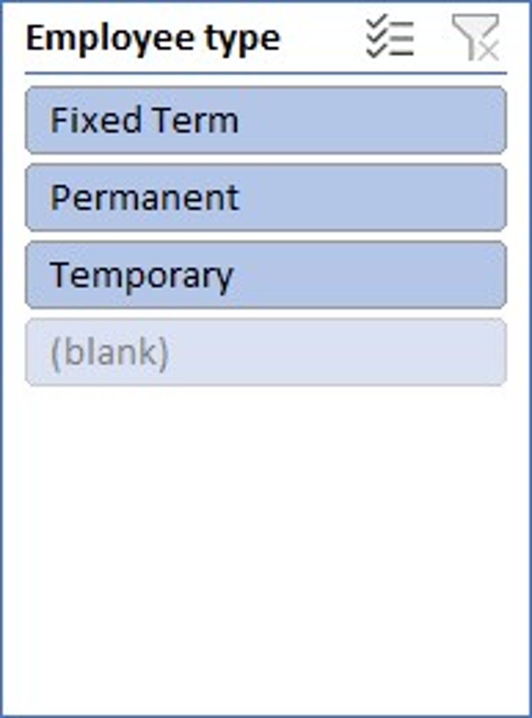
Results
Gender | (Multiple Items)
Sum of Salary | Column Labels
Row Labels | HIGH | LOW SALARY | MODERATE | VERY HIGH | Grand Total
Accounting | 349332.2 | 36547.58 | 309659.98 | 573406.42 | 1268946.18
Engineering | 61624.77 | 76505.98 | 141547.37 | 720714.1 | 1000392.22
Human Resources | 208360.35 | 35943.62 | 50310.09 | 439710.33 | 734324.39
Marketing | 270480.25 | 69178.87 | 40753.54 | 271441.52 | 651854.18
Product Management | 276473.77 | 108117.72 | 40445.29 | 927183.45 | 1352220.23
Research and Development | 74279.01 | 67861.61 | 207079.53 | 458340.76 | 807560.91
Sales | 131055.87 | 71727.64 | 41934.71 | 349307.37 | 594025.59
Services | 208028.03 | 31172.77 | 132123.11 | 869065.47 | 1240389.38
Support | 196694.84 | 66036.13 | 177452.3 | 463436.97 | 903620.24
Training | 71570.99 | 75804.7 | 223644.71 | 1100267.07 | 1471287.47
Grand Total | 1847900.08 | 638896.62 | 1364950.63 | 6172873.46 | 10024620.79

Slide 12
Conclusion
From the result we can conclude that the salary fluctuation is very nor very less.
If this continues there is a chance were the employees quit their job and find another company.
Salary should be equal to all the same department employee.

